Slide 1
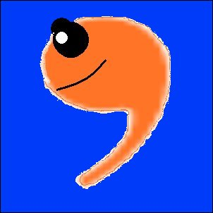

Apostrophe Abuse
Please learn to use
me, not abuse me!

Slide 2
Students are not the only ones who misuse and abuse apostrophes.

Slide 3
Check out these “professional” signs.

Slide 4
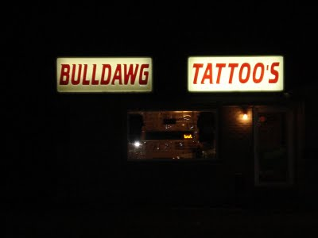
What’s wrong with this picture?

Slide 5
Tattoos, not tattoo’s!
Hope that tattoo needle
has a good spell check!

Slide 6
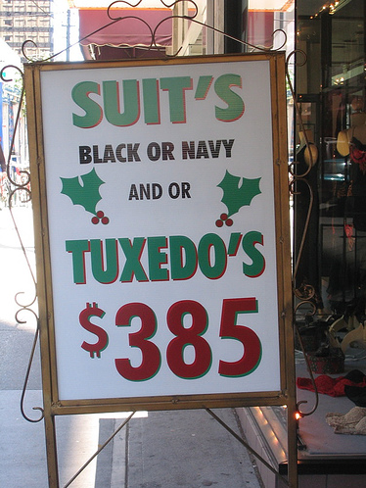
What’s wrong with this picture?

Slide 7
SUITS, not SUIT’S
TUXEDOS, not TUXEDO’S
It’s still
cheaper
to rent one!

Slide 8
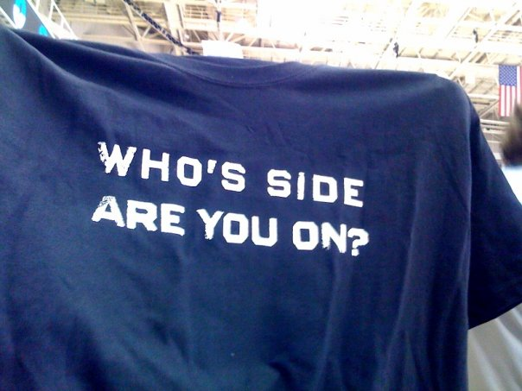
What’s wrong with this picture?

Slide 9
WHOSE, not who’s (who is)
We hope you’re
on the side of
good grammar!

Slide 10

What’s wrong with this picture?

Slide 11

PIES, not PIE’S
Doesn’t look
too fresh to me!

Slide 12

What’s wrong with this picture?

Slide 13
OREOS, not OREO’S
MMMM! MAKE MINE EXTRA GREASY!

Slide 14


What’s wrong with this picture?

Slide 15
NOTHING IS WRONG!
Wendy’s Old Fashioned Hamburgers
McDonald’s Restaurant

Slide 16
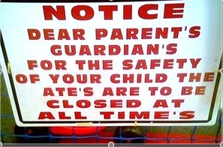
What’s wrong with this picture?

Slide 17
PARENTS, not PARENT’S
GUARDIANS, not GUARDIAN’S

Slide 18
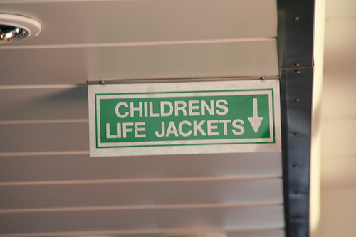
What’s wrong with this picture?

Slide 19
CHILDREN’S, not CHILDRENS

Slide 20

What’s wrong with this picture?

Slide 21
ITS, not IT’S
Bad grammar is NOT a bold move!

Slide 22
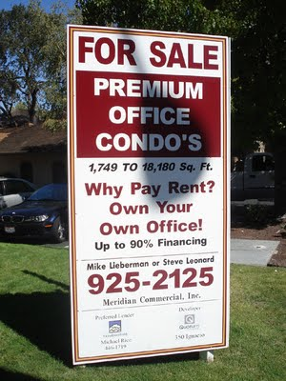
What’s wrong with this picture?

Slide 23
CONDOS, not
CONDO’S

Slide 24
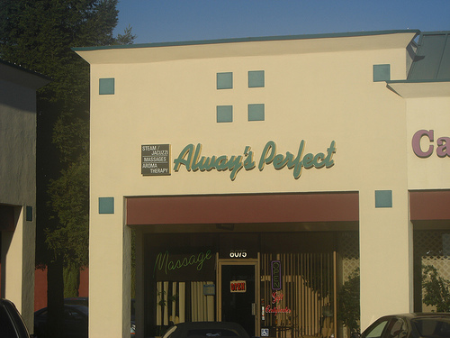
What’s wrong with this picture?

Slide 25

ALWAYS, not ALWAY’S
NOT AS
PERFECT
AS THEY
THINK!

Slide 26
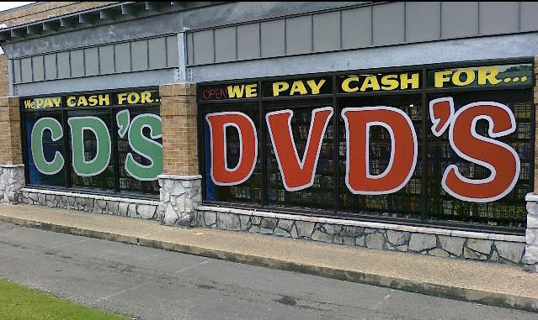
What’s wrong with this picture?

Slide 27

CDs, not CD’s
DVDs, not DVD’s
iPODs, not CDs!

Slide 28

What’s wrong with this picture?

Slide 29
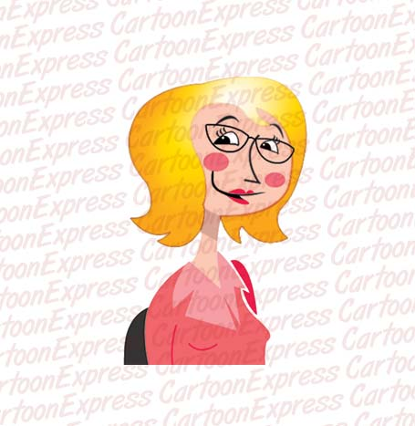
TEACHERS, not TEACHER’S
I NEED TO
SHAPE
THAT
PRINTER’S
GRAMMAR!

Slide 30
The End
Thank you for learning
How to use me properly!

